Slide 1
Making a Case for Using Relational Databases in Serverless Applications
Samuel Lock

Slide 2



Samuel Lock
Moved to Costa Rica (& discovered surfing)
↳ 2019 : Bootstrapped Founder w/Serverless
↳ 2020 : Startup AWS DevOps Engineer
↳ 2023 : Serverless Developer @ Serverless Guru
AWS SME @ Toptal Freelancing
↳ 2024 : Solution Architect @ Serverless Guru
Amazon Authorized Instructor (AAI) @ AWS
Moved back to UK (& still can’t surf)

Slide 3

Our plans for today
(R)elational (D)ata(B)ase (M)anagement (S)ystems - e.g MySQL, Postgres
5 minutes
Why RDBMS don’t suit serverless
10 minutes
When RDBMS should be considered
10 minutes
How to improve the RDBMS DX
Q&A

Slide 4
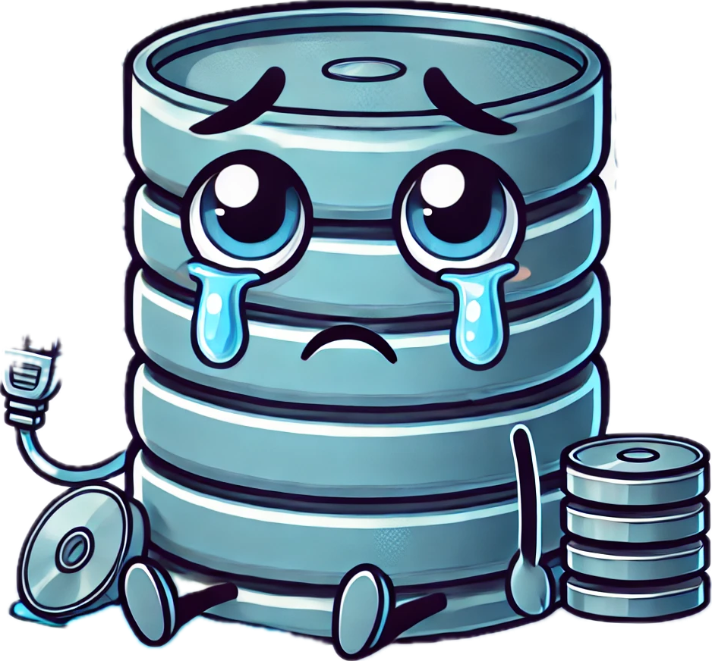
Why Relational Databases Don’t Suit Serverless

Slide 5
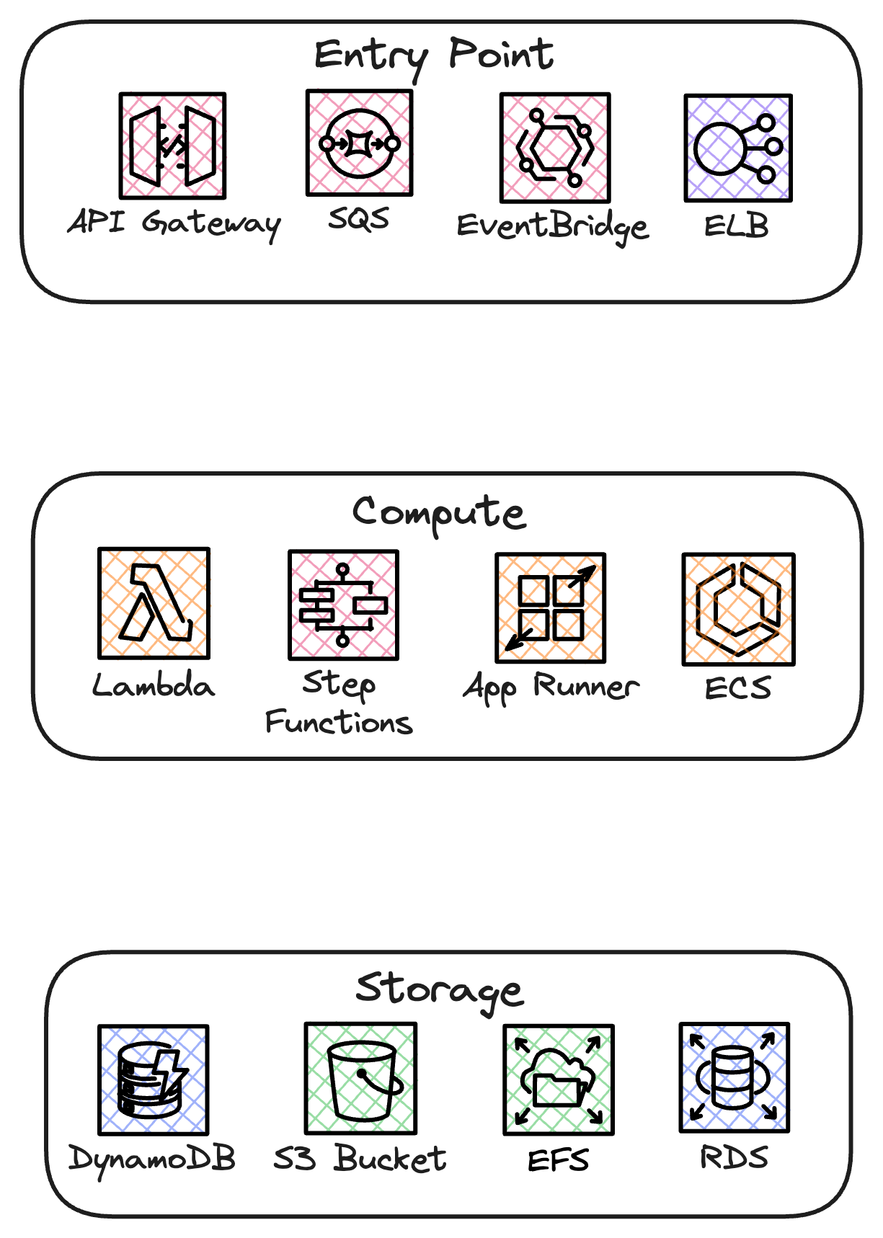
“Relational databases don’t scale”
✅
✅
✅
✅
✅
✅
✅
✅
✅
✅
✅
⛔

Slide 6


“Relational databases are slow”
Relational Databases
DynamoDB
↳ ACID Compliance
❌
✔
🍹
Notes:
I = Isolation

Slide 7
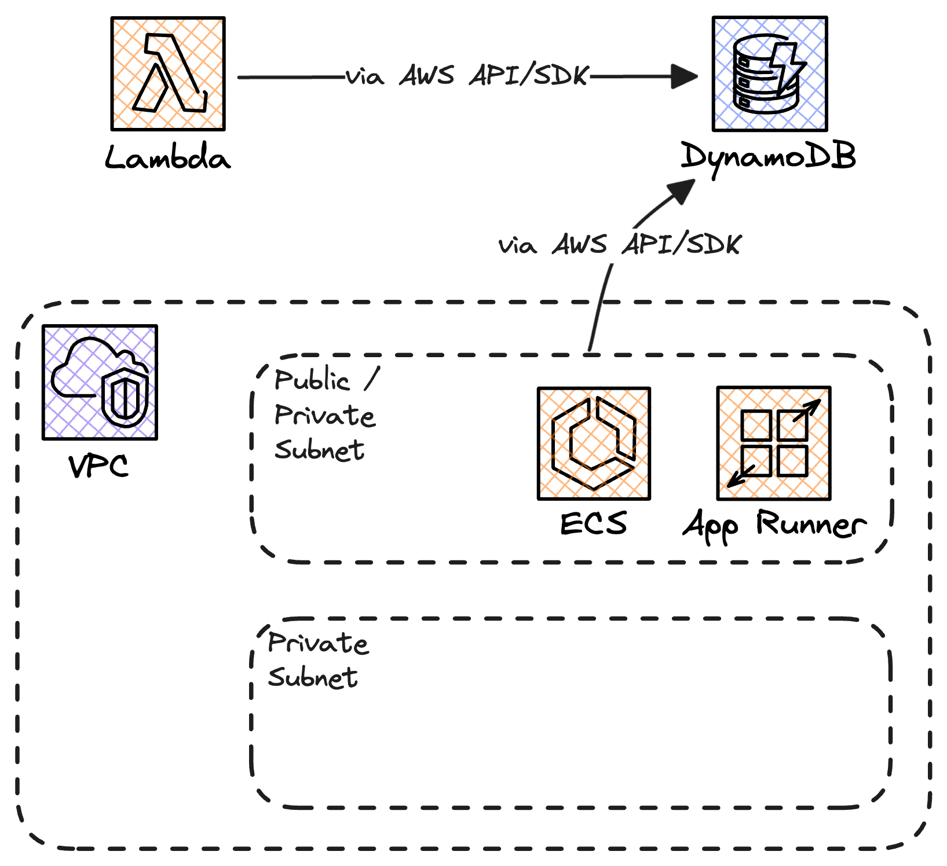
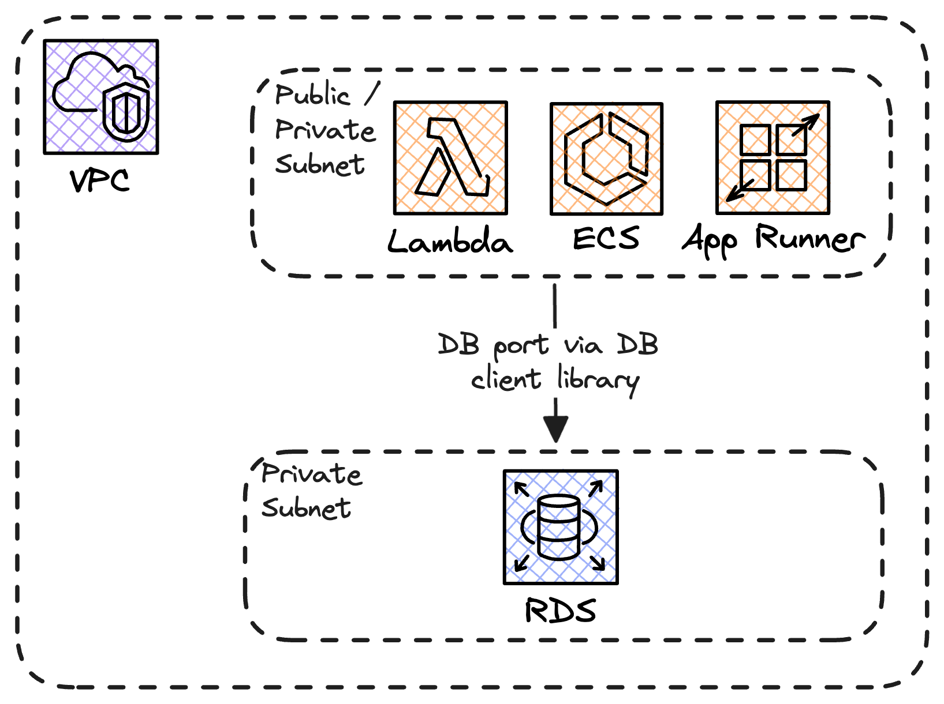
“Relational databases require a VPC”

Slide 8
“Relational database pricing doesn’t scale to zero”
Dynamo DB vs Aurora Serverless v2
Cost →
Usage →

Slide 9
Why are we here?
“Relational databases don’t scale”
“Relational databases require a VPC”
“Relational databases are slow”
“Relational database pricing doesn’t scale to zero”

Slide 10

When Relational Databases should be considered
↳Highly-compliant industries
↳Migrating legacy applications using RDBMS already
↳When your data is naturally relational
↳When you don’t know your access patterns

Slide 11
When Relational Databases should be considered
 | DynamoDB | RDBMS Options (RDS, Aurora)
Request Body Size | 16 Mb / 25 items (via BatchWriteItem) | N/A (4 Mb w/ Data API)
Response Size Limit | 1 Mb | N/A (1 Mb w/ Data API)
Item Size Limit | 400 Kb | N/A (64 Kb returned w/Data API)
Request Concurrency | 40K RRUs + 40K WRUs | Dictated by ACUs / DB instance size
Other Notes | ↳ DynamoDB Streams ↳ TTL ↳ Point-in-time Recovery | ↳ Backtrack (Point-in-time recovery)

Slide 12
Read-Heavy Scenario
All Items/Rows are 4 Kb | 500 TPS (All Reads) | 100,000 Items/Rows (400Gb)
 | DynamoDB | Aurora Serverless v2 | RDS
Price of Requests | $0.25 per/m | $0.02 per/m (estimated I/O cost) | N/A
First 10 TB of Data Out | $0.09 per GB, $0 within region. | $0.09 per/GB (internet) $0.02 per/GB to other AWS regions/AZ | $0.09 per/GB (internet) $0.02 per/GB to other AWS regions/AZ

Slide 13
Read-Heavy Scenario
All Items/Rows are 4 Kb | 500 TPS (All Reads) | 100,000 Items/Rows (400Gb)
 | DynamoDB | Aurora Serverless v2 | RDS
Requests (1.3 B) | $325 /month | $26 /month | N/A
Compute | N/A | $432 /month (assuming 5x ACU) | $485 (assuming 2x m7g.xlarge)
Storage (400 Gb) | $100 /month | $40 /month | $46 /month
Data Out (5.18 Tb) | $0 (Assuming same region) | $0 (Assuming same AZ) | $0 (Assuming same AZ)
Total | $425 /month | $458 /month | $531 /month

Slide 14
Write-Heavy Scenario
All Items/Rows are 4 Kb | 50 TPS (All Writes) | 100,000 Items/Rows (400Gb)
 | DynamoDB | Aurora Serverless v2 | RDS
Price of Requests (up to 1 B) | $0.25 $5 per/m | $0.02 $0.20 per/m (I/O cost) | N/A
First 10 TB of Data Out | $0.09 per GB, $0 within region. | $0.09 per/GB (internet) $0.02 per/GB to other AWS regions/AZ | $0.09 per/GB (internet) $0.02 per/GB to other AWS regions/AZ

Slide 15
Write-Heavy Scenario
All Items/Rows are 4 Kb | 50 TPS (All Writes) | 100,000 Items/Rows (400Gb)
 | DynamoDB | Aurora Serverless v2 | RDS
Requests (130M) | $325 $650 /month | $26 /month | N/A
Compute | N/A | $432 $260 /month (assuming 3x ACU) | $485 (assuming 2x m7g.xlarge)
Storage (400 Gb) | $100 /month | $40 /month | $46 /month
Data Out (5.18 Tb) | $0 (Assuming same region) | $0 (Assuming same AZ) | $0 (Assuming same AZ)
Total | $750 /month | $326 /month | $531 /month

Slide 16
Combined Scenario
All Items/Rows are 4 Kb | 500 TPS (Reads) + 50 TPS (Writes) | 100,000 Items/Rows (400Gb)
 | DynamoDB | Aurora Serverless v2 | RDS
Reads | $325 /month | $458 /month | N/A
Writes | $650 /month | $286 /month | N/A
Both | $100 /month | $40 /month | $531 /month
Total | $1075 /month | $784 /month | $531 /month

Slide 17
Improving The Developer Experience

Slide 18

ORMs
+ Keeps your code simple
+ Manages table schema
- JS is loosely typed
- DB migrations require centralization
- Bloat your Lambda package

Slide 19


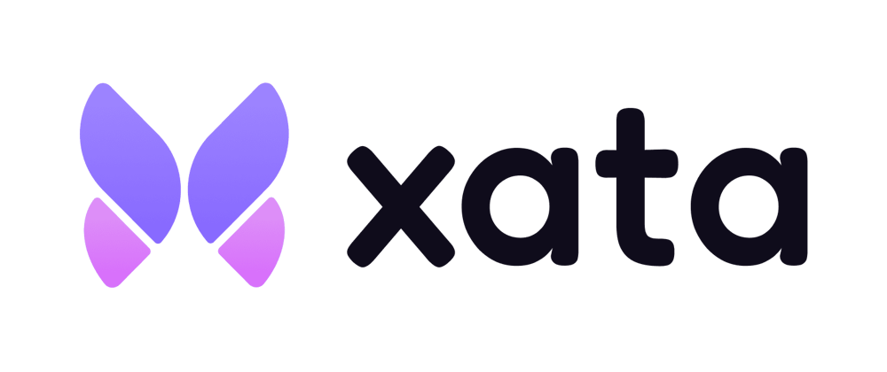


The Data API
Replace with Aurora Serverless v2
Have your cake and eat it.
Have your (cup)cake and eat it.
Notes:
First 1B: $0.35/million
Above 1B: $0.20/million
(Aurora sls = $0.20/million already)
Announced Dec 2023

Slide 20

Ephemeral Environments
↳ Data API to create tables and seed
↳ 3rd parties offer branching:

Slide 21

That’s it folks!
Thank you!

Slide 22




Time for
Q&A.
https://www.linkedin.com/in/serverless-sam
https://www.serverlesssam.com

